Slide 1
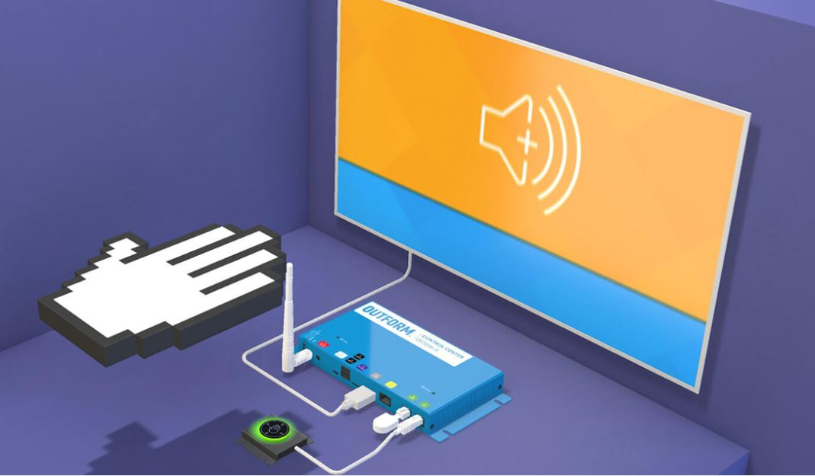

Project Phase II
FINAL YEAR PROJECT
Topic name : Controlling Computer using Hand Gestures
Guided by : Rajesh Prasad
Group ID: 22
Group Members [Final Year IS-2]
Pradnya Kedari (2183149 IS -2)
Shubhangi Kadam (2183214 IS- 2)

Slide 2
Outline
Abstract
Background and Motivation
Problem Statement
Objectives
Introduction
Literature Survey
Experimental Setup
Implementation
Code
Result
Applications
Conclusion
Acknowledgement
References

Slide 3
Abstract
Gesture is one of the most vivid and dramatic way of communications between human and computer. Hence, there has been a growing interest to create easy-to-use interfaces by directly utilizing the natural communication and management skills of humans.
The presence on market of the low-cost webcams with, at least, satisfactory qualities open up new directions regarding the implementation of human computer interaction (HCI) interfaces.
Our objective is to build and train a model for feature extraction and classification of hand gestures and recognizing an action and performing an operation accordingly.

Slide 4
Background and Motivation
Hand gesture recognition system contains a decent surveillance present days thanks to simple and straightforward intercommunication between human and machine.
The most important advantage of the usage of hand gesture based input modes is that using this method the user can interact with the application from a distance without any physical interaction with the keyboard or mouse.
Most of the methods used Arduino and sensors, directly device webcam is used in very few methods.
The dataset we selected before have overfitting problem.

Slide 5
Problem Statement
“Controlling Computer using Hand Gestures”
In this project we will develop the Computer Vision project to perform activities on laptop/PC with the help of hand gestures using a webcam.

Slide 6
Objectives
To build and train a model for feature extraction and classification of hand gestures.
To use a trained model for classification of hand gestures and recognizing a action and perform an operation accordingly.
To control a computer and perform related activities using hand gestures.

Slide 7
Introduction
What is hand gestures?
Hand gesture recognition is one obvious way to create a useful, highly adaptive interface between machines and their uses.
Hand gesture recognition technology would allow for the operation of complex machines using only a series of finger and hand movements, eliminating the need for physical contact between operator and machine.
By implementing this system, efforts of interaction with computers will be reduced and interaction will be more easy. Also system will able to recognize and interpret movements of the hand in order to interact with and control a computer system.

Slide 8
Literature survey
Sr. No. | Authors | Name | Methodology | Limitations
1 | J.R Pansare, Malvika Bansal, Shivin Saxena, Devendra Desale | “Gestuelle: A System to Recognize Dynamic Hand Gestures using Hidden Markov Model to Control Windows Applications”, International Journal of computer associations, January 2013. | Developed application that recognizes and perform task such as zoom in and out, rotating image. Baum-Welch algorithm was used for training process and own data-set was used. | There might be miss-recognitions in case the background has elements that resemble the human skin and only for image purpose.
2 | Pei Xu | “A Real-time Hand Gesture Recognition and Human-Computer Interaction System”, April 2017. | A real-time gesture-based HCI system who recognizes gestures only using one monocular camera. | Background environment may be cluttered, changeable and unpredictable.
3 | Gopi Manoj, Vuyyuru Malvika, Ramesh Shirke | “Performing Basic Tasks on Computer using Hand Gestures & Ultrasonic Sensors”, May 2021 | Jumper Wires Universal Serial Bus (USB) Cable, Arduino, ultrasonic sensors | When there are multiple hands the movement is not detected.

Slide 9
4 | Yash Velaskar, Akshay Dulam, Sagar Sureliya | “Computer Vision based Hand Gesture Interfaces”, 2017. | In this project they have performed hand gestures for performing file handling. Image is pre-processed by techniques like color space detection, color space conversion [ YCrCb, HSV, RGB] | There might be miss-recognitions in case the background has elements that resemble the human skin and only for image purpose.
5 | Rohit Mukherjee, Pradeep Swethen, Ruman Pasha, Sachin Singh Rawat | “Hand Gestured Controlled laptop using Arduino”, October 2018. | Hand gesture laptop uses an Arduino Uno, Ultrasonic sensors and a laptop to carry out the operation of controlling media playback and volume. Arduino, ultrasonic sensors. Python used for serial connection. | Sensors sometimes may not detect actions. Only for controlling media features.
6 | Ayushi Bhawal, Debaparna Dasgupta, Arka Ghosh, Koyena Mitra, Surajit Basak | “Arduino Based Hand Gesture Control of Computer”, June 2020. | Arduino based hand gesture controlled computer where they can play pause videos and scroll up and down pages. Arduino ,ultrasonic sensors. Python used for serial connection. | Only for Video applications When there are multiple hands the movement is not detected.

Slide 10
7 | Sarita K., Gavale Yogesh, S. Jadhav | “Hand Gesture Detection Using Arduino And Python For Screen Control”, July 2020. | Arduino based hand gesture controlled computer where they can zoom in/out and rotate the image. Arduino, Python used for implementation. | When there are multiple hands the movement is not detected.
8 | Udit Kumar, Sanjana Kintali, Kolla Sai Latha, Asraf Ali, N. Suresh Kumar | “Hand Gesture Controlled Laptop Using Arduino”, April 2020. | Developed such application that scroll up and down web pages and moving to next and previous pages. Arduino, used. | Hand should be within the range limit.
9 | J. S. Vimali, Senduru Srinivasulu, J. Jabez, S. Gowr | “Hand Gesture Recognition Control for Computers Using Arduino”, 2020. | Tab switch in a Web browser, Web page scrolling, Task switching, Play/pause the video, Video forward and rewind, etc. applications performed. Arduino, PySerial, PyautoGUI, etc. used. | When there are multiple hands the movement is not detected.
10 | Ram Pratap sharma, Gyanendra Varma | “Human computer interaction using hand gesture”, 2015. | HCI for MS office and media player. Have their own dataset, used skin coloured based technique. | Less robust in detection and recognition.

Slide 11






Experimental Setup
Technologies and Platform:
Anaconda & PyCharm
Python (Tensorflow and keras, Numpy, Pandas)
OpenCV
Deep Learning

Slide 12
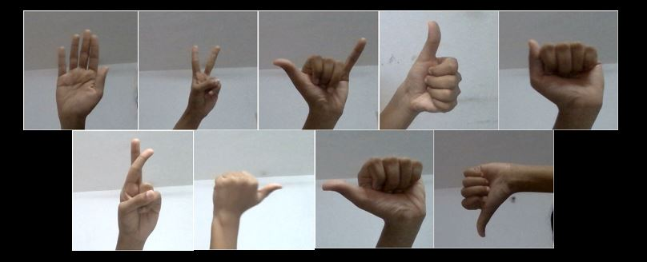
Implementation
DATASET: We tried to use available dataset, but we faced overfitting problem. Thus we create our own dataset for training the model. We took total 10 different hand gestures to perform activities like opening the WhatsApp, PowerPoint presentation, Microsoft Edge, Google Chrome, Video Player, etc.
Fig. Dataset Images
We took total 300 images of each gesture that means total 3000 images for training and testing.

Slide 13
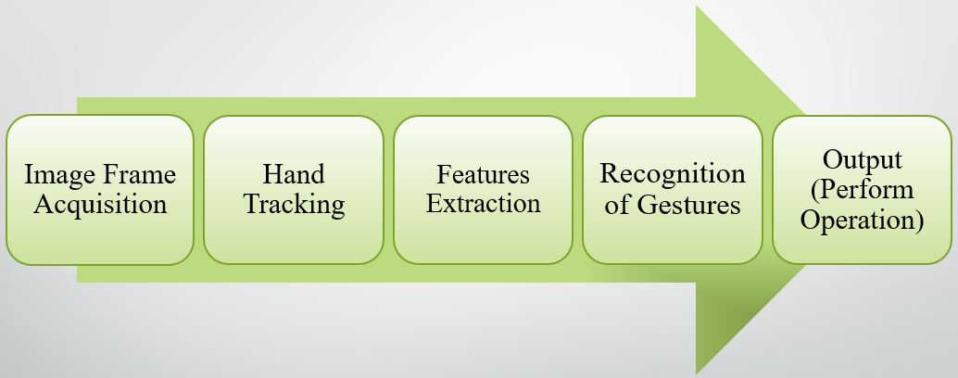
2. IMPLEMENTATION: System
We have define two modules for this system and they are:
Train The Hand Gesture Recognizer Model
Recognize The Hand Gesture And Perform Actions
Fig. Methodology of Proposed System
We also added one more functionality in our implementation that tells user which action is performed.

Slide 14
CNN Architecture
Flattening
Dense
Convolution
Max Pooling
Convolution
Max Pooling
ReLU
Input
Convolution
Max Pooling
Softmax
Output
Fully Connected
Feature Extraction
Classification

Slide 15
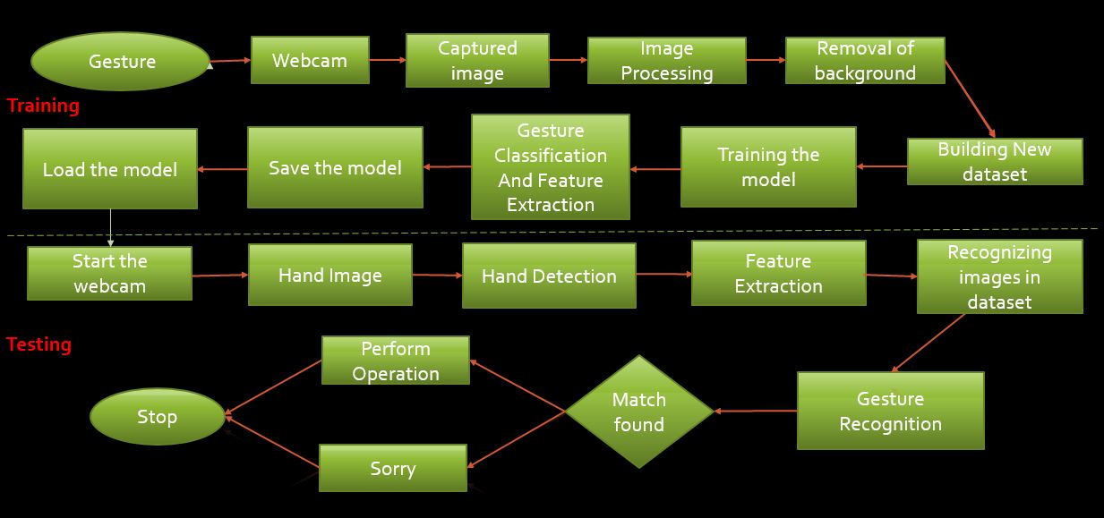
Fig. Workflow of Proposed System

Slide 16
Code

Slide 17
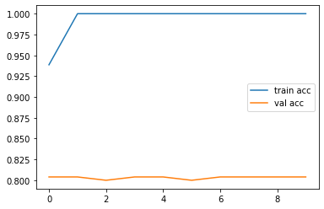
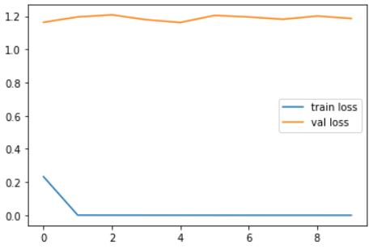
RESULT
Following are the two plots of train-val accuracy and train-val loss.
Fig. Train vs Val accuracy
Fig. Train vs Val loss

Slide 18
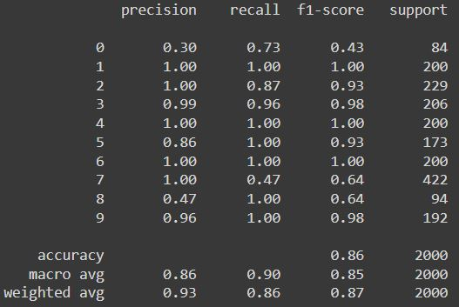
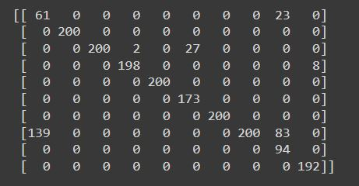
We achieved following result of evaluation metrics. Our model is confused in some of the gestures like cross, scissor, up, etc. We achieved 85.90% accuracy at the time of testing our model. Following are the classification reports we got.
Fig. Confusion Matrix
Fig. Overall Result of Model

Slide 19
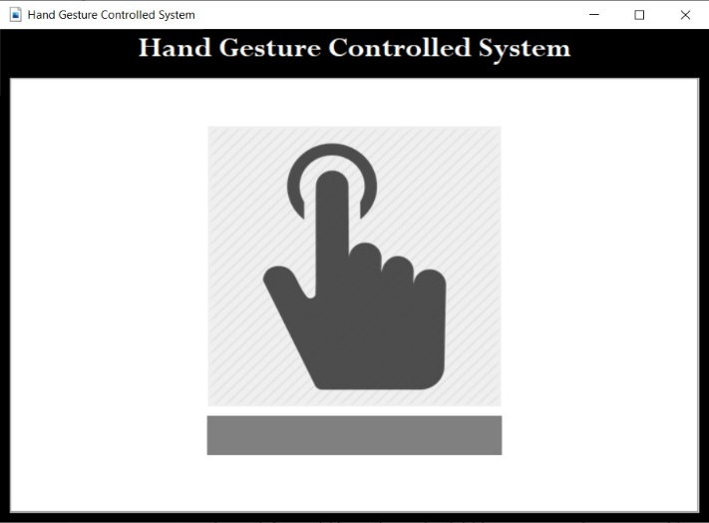
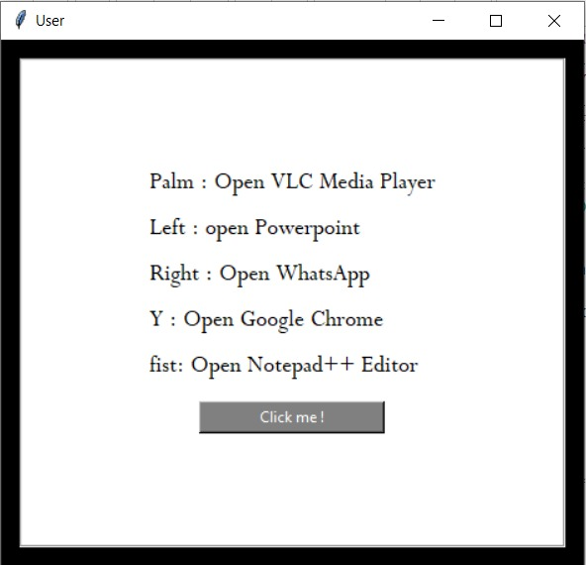
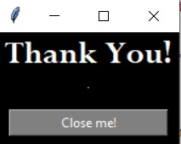
GUI of our system,

Slide 20
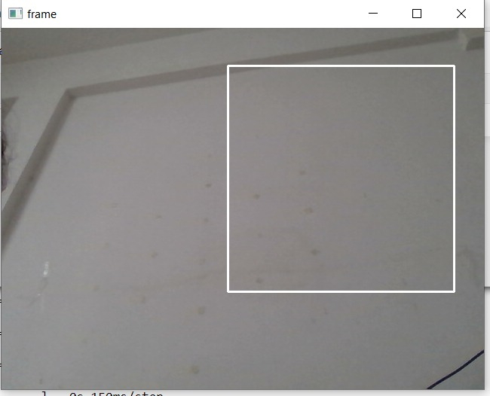
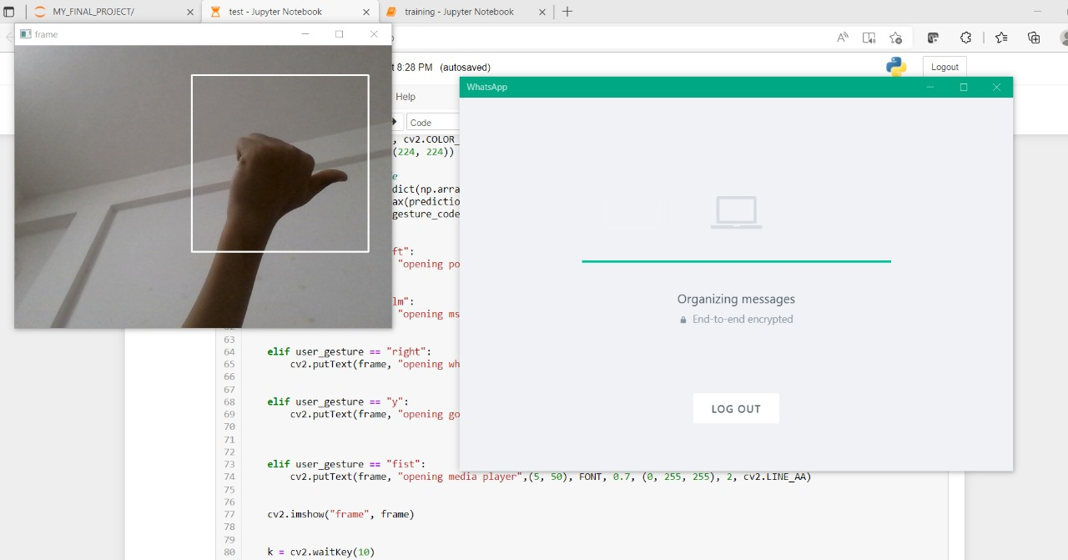
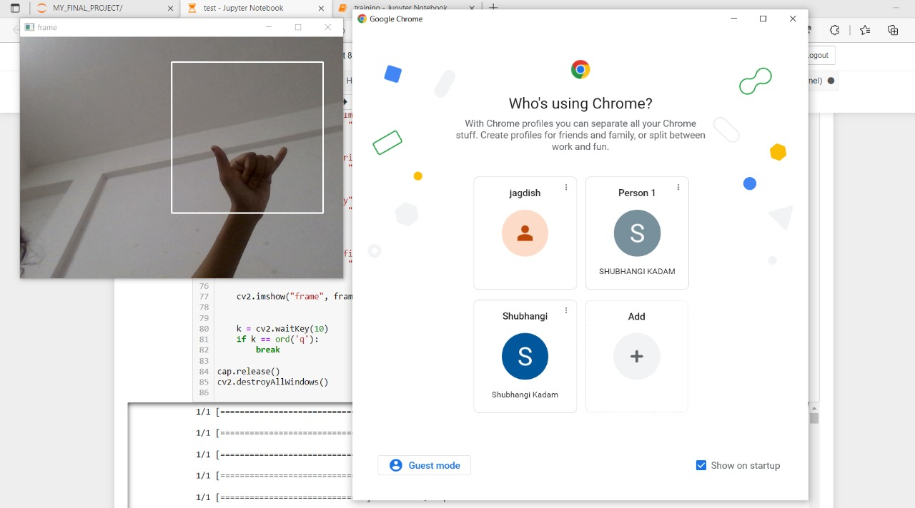
Some demons of the developed system,

Slide 21
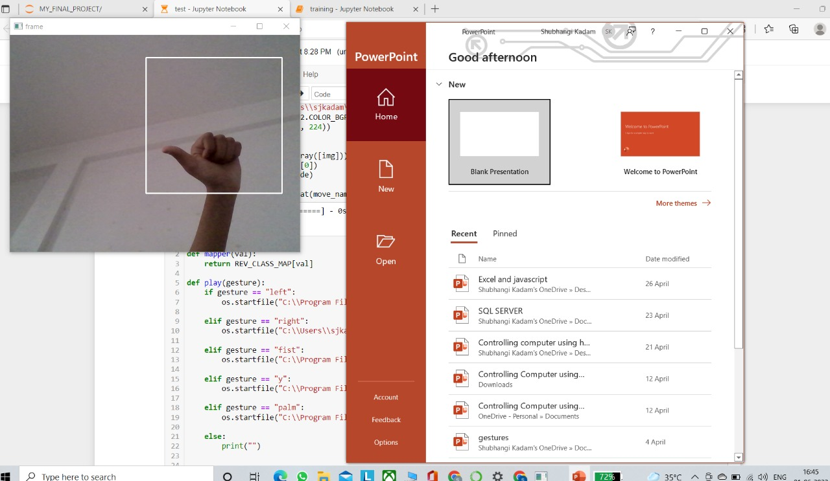
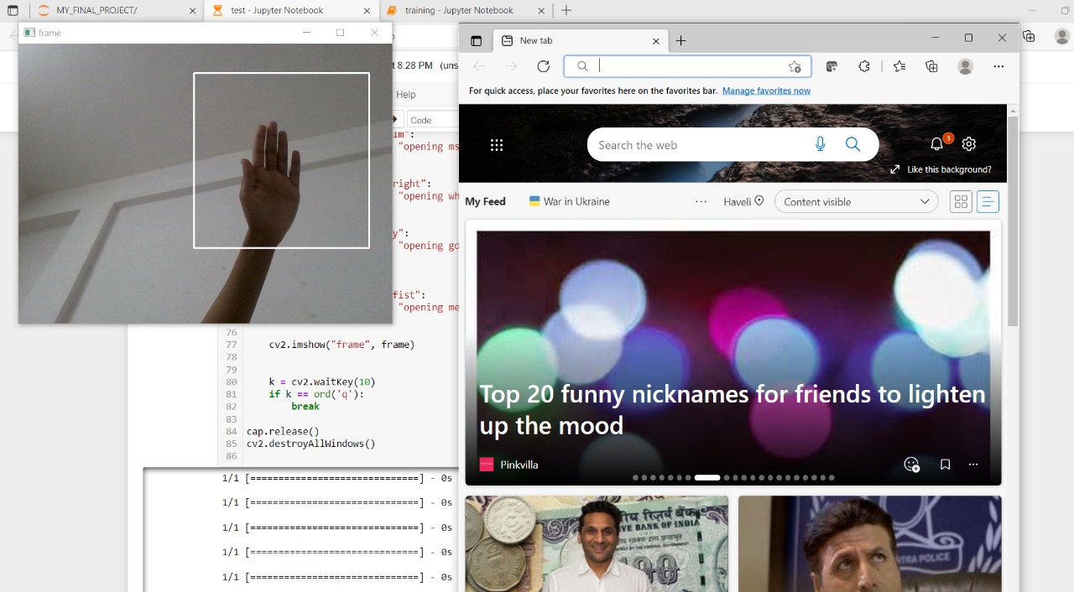
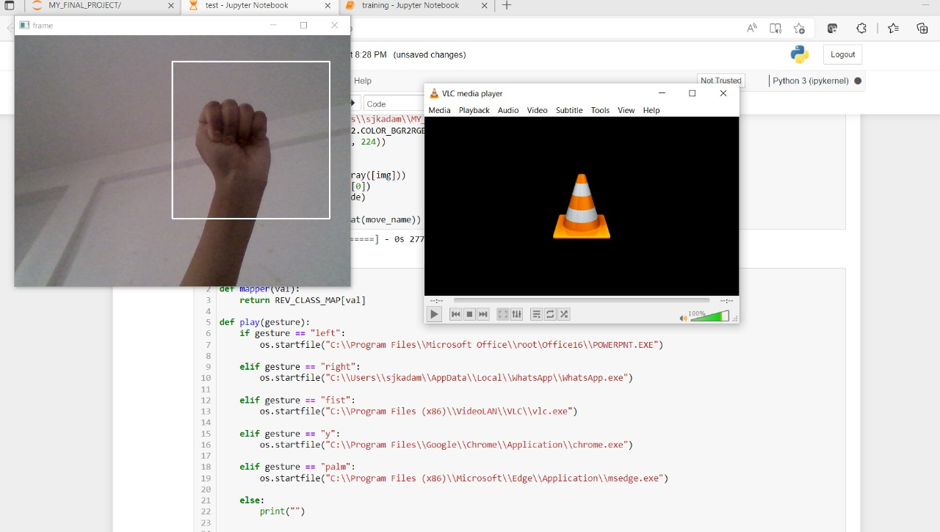

Slide 22
Applications
Immersive gaming technology
Control through facial gestures
Alternative computer interfaces
Remote control
Home Applications control
Gaming
Medical Applications

Slide 23
Conclusion
With the growth of present technology, and as humans generally makes the use of hand movements that is hand gestures in the daily communication in order to make intentions more clear, hand gesture identification is treated to be a crucial portion of Human Computer Interaction (HCI), which provides devices the capability of detecting and classifying hand gestures, and perform activities subsequently.
Research and analysis in the field of hand gestures has become more popular and exciting. It also allows a way of natural and simple interaction.
In this application, we developed a deep learning model for controlling a computer using hand gestures with the help of Python and OpenCV. It is the cost effective model. We can define a project as creating a dataset, training a model and testing this model in real time.

Slide 24
This project have limited scope, but in future we can add more operations like volume up/down, scroll up/down, swipe left/right and many more, and can possible to make completely hand gestures controlling device.
Hand gesture recognition used in many applications like HCI, robotics, sign language, digit and alphanumeric value, home automation, medical applications, gaming etc. Hand gestures recognition provides an interesting interaction field in a several different computer applications.
With the development of today’s technology, and as humans tend to naturally use hand gestures in their communication process to clarify their intentions, hand gesture recognition is considered to be an important part of Human Computer Interaction (HCI), which gives computers the ability of capturing and interpreting hand gestures, and executing commands afterwards.

Slide 25
ACKNOWLEDGEMENT
We would like to express our special thanks and gratitude to our guide Rajesh Prasad sir who gave us the guidance and support to complete this project. We would also like to extend our gratitude to Principal Sir Dr. Kishore Ravande sir, to the Dean Engineering, Dr. Rajneeshkaur Sachdeo ma’am and to the HOD CSE Dr. Shraddha Phansalkar ma’am for providing us with all the facility that was required.
By doing this project we have gained a lot of knowledge which can help us in the near future.

Slide 26
References
We have published a survey paper named “A Survey Paper on Controlling Computer using Hand Gestures” in the International Research Journal of Engineering and Technology (IRJET) journal .
In this paper we have discussed the overall review of gesture acquisition methods, the feature extraction process, the classification of hand gestures, the challenges that face researchers in the hand gesture recognition process.
Publication Site: https://www.irjet.net/
Link for our published survey paper:
https://www.irjet.net/archives/V9/i2/IRJET-V9I2181.pdf

Slide 27
References
J.R Pansare, Malvika Bansal, Shivin Saxena, Devendra Desale, "Gestuelle: A System to Recognize Dynamic Hand Gestures using Hidden Markov Model to Control Windows Applications", International Journal of Computer Applications (0975 – 8887) Volume 62– No.17, January 2013.
Pei Xu, "A Real-time Hand Gesture Recognition and Human-Computer Interaction System", arXiv:1704.07296v1 [cs.CV] 24 Apr 2017.
Gopi Manoj, Vuyyuru Malvika, Ramesh Shirke, “Performing Basic Tasks on Computer using Hand Gestures & Ultrasonic Sensors”, May 2021.
Yash Velaskar, Akshay Dulam, Sagar Sureliya, “Computer Vision based Hand Gesture Interfaces”, 2017.
Rohit Mukherjee, Pradeep Swethen, Ruman Pasha, Sachin Singh Rawat, “Hand Gestured Controlled laptop using Arduino”, International Journal of Management, Technology And Engineering, October 2018.

Slide 28
6. Ayushi Bhawal, Debaparna Dasgupta, Arka Ghosh, Koyena Mitra, Surajit Basak, “Arduino Based Hand Gesture Control of Computer”, IJESC, Volume 10, Issue No.6, June 2020.
7. Sarita K., Gavale Yogesh, S. Jadhav, “HAND GESTURE DETECTION USING ARDUINO AND PYTHON FOR SCREEN CONTROL”, International Journal of Engineering Applied Sciences and Technology, 2020, Vol. 5, Issue 3, ISSN No. 2455-2143, July 2020.
8. Udit Kumar, Sanjana Kintali, Kolla Sai Latha, Asraf Ali, N. Suresh Kumar, “Hand Gesture Controlled Laptop Using Arduino”, April 2020.
9. J. S. Vimali, Senduru Srinivasulu, J. Jabez, S. Gowr, “Hand Gesture Recognition Control for Computers Using Arduino”, 2020.
10. Ram Pratap Sharma and Gyanendra K. Verma, "Human Computer Interaction using Hand Gesture", Eleventh International Multi-Conference on Information Processing-2015 (IMCIP-2015).

Slide 29
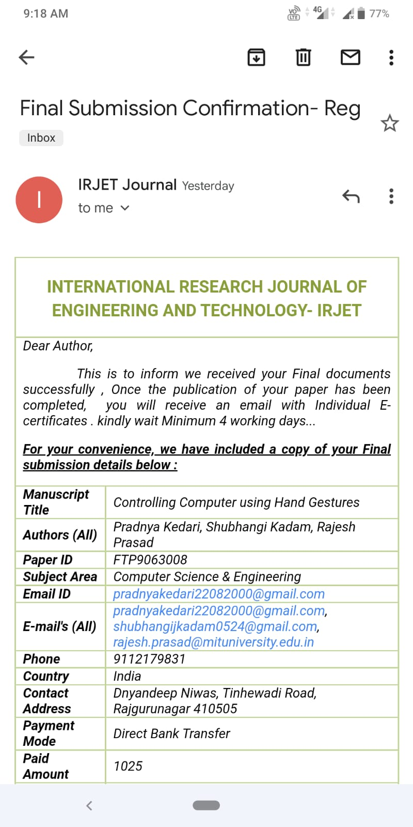
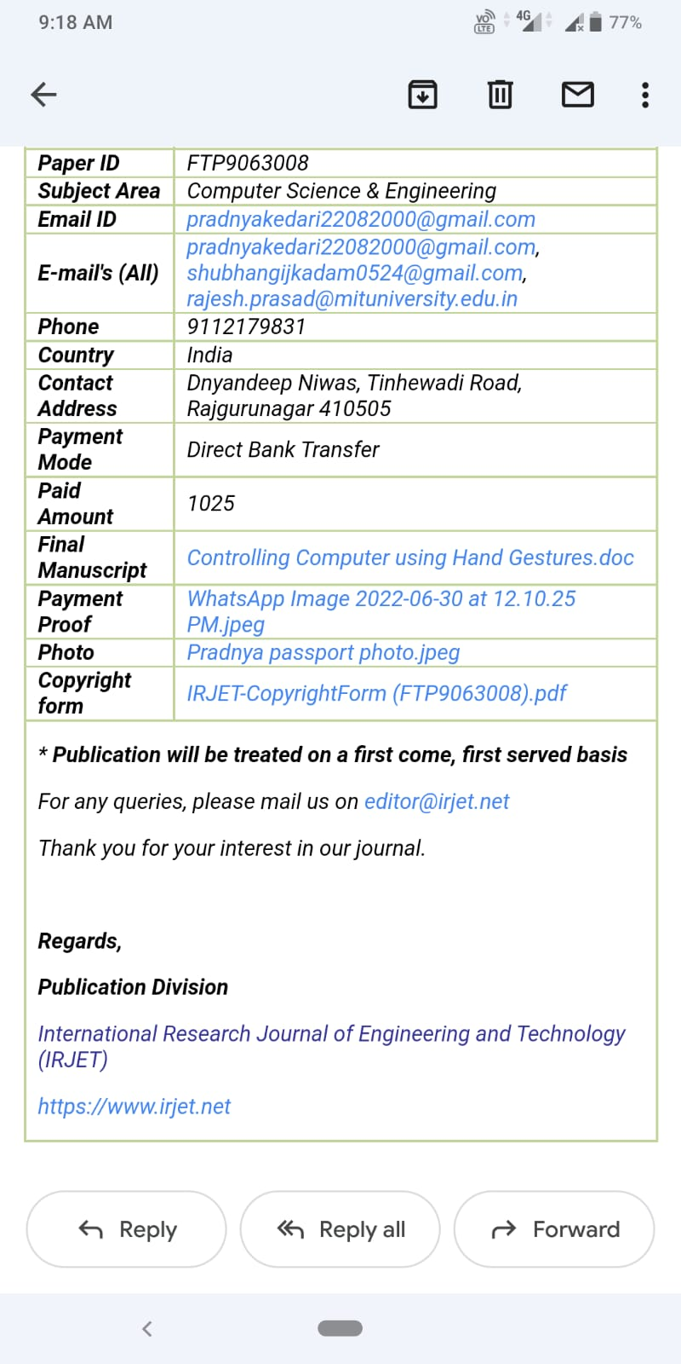
Paper Publication

Slide 30
Thank you !!

